Slide 1
Introduction to LangChain
Dr. Jamal Abdullahi Nuh

Slide 2
Overview & Features
LangChain Overview:
Development framework for AI-powered applications.
Supports JavaScript and Python.
Connects AI applications to external data sources.
Easy swapping of components (e.g., models, vector stores).
Key Features:
Connect AI applications to external data.
Swap components easily (e.g., OpenAI models, vector stores).
Provides in-depth information on execution steps.

Slide 3

Setting Up the Development Environment
Creating a Virtual Environment:
Open terminal in your project folder.
Run python -m venv venv to create a virtual environment.
Activate the environment with venv\Scripts\activate.
Installing Dependencies:
Install LangChain:
pip install langchain.
Install OpenAI integration:
pip install langchain-openai.

Slide 4
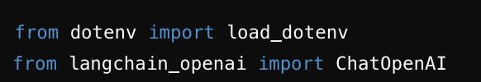
Basic LangChain Setup
Creating
Creating a New Python File:
Create a file named llm.py.
Importing
Importing Necessary Libraries:
from dotenv import load_dotenv
from langchain_openai import ChatOpenAI

Slide 5
Initializing the Language Model
Instantiate the Model:
load_dotenv()
llm = ChatOpenAI
(
model="gpt-3.5-turbo",
temperature=0.7,
)
Setting Parameters:
model: Specify the model (e.g., gpt-3.5-turbo).
temperature: Control creativity (0.0 to 1.0).

Slide 6


Interacting with the Model
Basic Invocation:
response = llm.stream("Write a poem about AI")
Streaming Response:
for chunk in response:
print(chunk.content, end="", flush=True)

Slide 7

Environment Variables for Security
Storing API Key Securely:
Create a .env file in your project folder.
Add your API key: OPENAI_API_KEY=your_api_key_here.
Loading Environment Variables:
from dotenv import load_dotenv
load_dotenv()

Slide 8
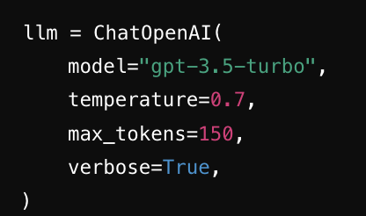
Advanced Configuration
Model Options:
model: Choose from a list of available models.
temperature: Set between 0.0 (factual) to 1.0 (creative).
max_tokens: Limit the number of tokens per generation.
verbose: Enable detailed logging for debugging.
Example
llm = ChatOpenAI(
model="gpt-3.5-turbo",
temperature=0.7,
max_tokens=150,
verbose=True,
)

Slide 9
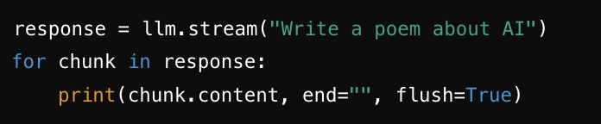
Batch Processing and Streaming
Batch Processing:
responses = llm.batch(["Hello, how are you?", "Write a poem about AI"])
Streaming Responses:
response = llm.stream("Write a poem about AI")
for chunk in response:
print(chunk.content, end="", flush=True)

Slide 10
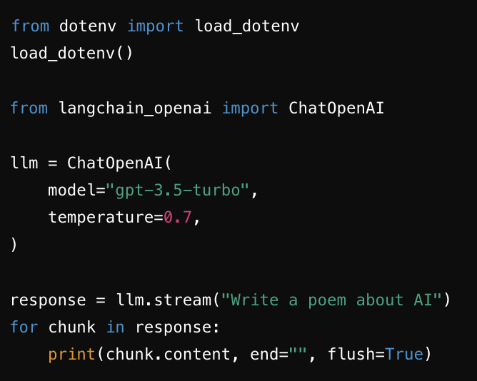
Practical Example and Testing
from dotenv import load_dotenv
load_dotenv()
from langchain_openai import ChatOpenAI
llm = ChatOpenAI(
model="gpt-3.5-turbo",
temperature=0.7,
)
response = llm.stream("Write a poem about AI")
for chunk in response:
print(chunk.content, end="", flush=True)

Slide 11
print(chunk.content, end="", flush=True)
chunk.content
refers to the content of the current chunk being processed. A "chunk" is a part of the data being streamed or processed in segments.
end="":
Normally, the print function in Python adds a newline (\n) character at the end of the output.
The end parameter changes this behavior. By setting end="", you are specifying that nothing should be added at the end of the printed string. This means that all chunks will be printed consecutively on the same line without any spaces or newlines between them.
flush=True:
Normally, Python's print function buffers the output, which means it may delay printing until the buffer is full or the program ends.
The flush parameter, when set to True, forces the print function to flush the output buffer immediately. This means the output will be printed to the screen as soon as the print function is called, without any delay.

Slide 12
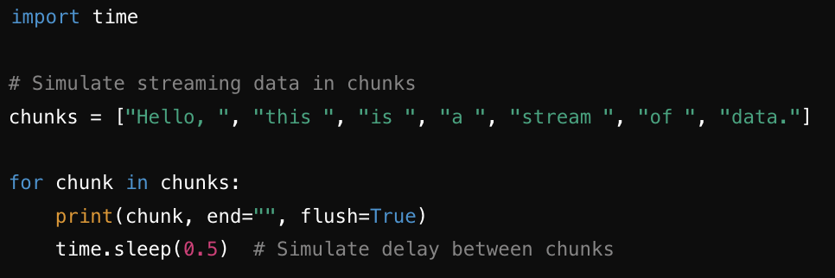
Normal Example
import time
# Simulate streaming data in chunks
chunks = ["Hello, ", "this ", "is ", "a ", "stream ", "of ", "data."]
for chunk in chunks:
print(chunk, end="", flush=True)
time.sleep(0.5) # Simulate delay between chunks

Slide 13
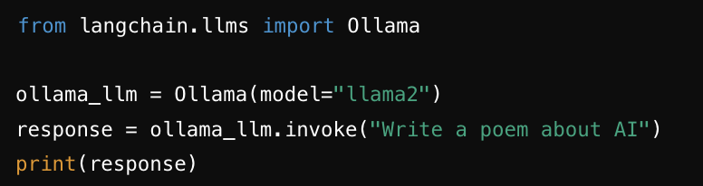
invoke, batch and stream Methods
1. invoke Method
Purpose: To make a single call to the language model and get a response.
Usage: This is used when you have a single prompt and want a single response.
Example:
from langchain.llms import Ollama
ollama_llm = Ollama(model="llama2")
response = ollama_llm.invoke("Write a poem about AI")
print(response)

Slide 14
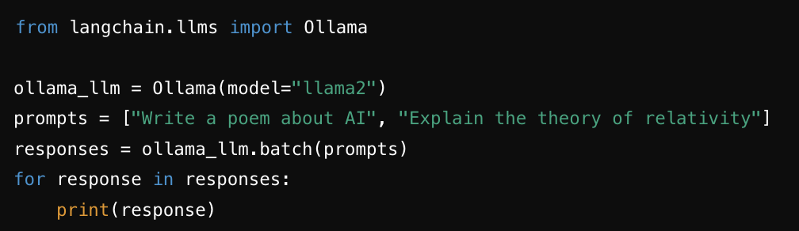
invoke, batch and stream Methods
batch Method
Purpose: To make multiple calls to the language model in a batch.
Usage: This is used when you have multiple prompts and you want responses for each of them in a single call.
Example:
from langchain.llms import Ollama
ollama_llm = Ollama(model="llama2")
prompts = ["Write a poem about AI", "Explain the theory of relativity"]
responses = ollama_llm.batch(prompts)
for response in responses:
print(response)

Slide 15
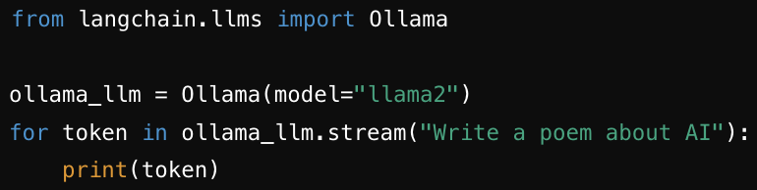
invoke, batch and stream Methods
stream Method
Purpose: To get a response from the language model in a streaming fashion.
Usage: This is used when you want to process parts of the response as they are generated, useful for real-time applications.
Example:
from langchain.llms import Ollama
ollama_llm = Ollama(model="llama2")
for token in ollama_llm.stream("Write a poem about AI"):
print(token)
Or you can write like this

Slide 16
In short
Invoke:
Single prompt, single response.
Useful for straightforward interactions.
Batch:
Multiple prompts, multiple responses in one call.
Efficient for bulk processing.
Stream:
Real-time token-by-token response.
Useful for real-time applications and handling long responses incrementally.

Slide 17
Running the Code:
Execute python llm.py in your terminal.
Observe the output streaming in the terminal.

Slide 18
Conclusion and Next Steps
What We Covered:
Introduction to LangChain and its features.
Setting up the development environment.
Interacting with the OpenAI and Ollama model.
Advanced configurations and batch processing.
Securely handling API keys.

Slide 19
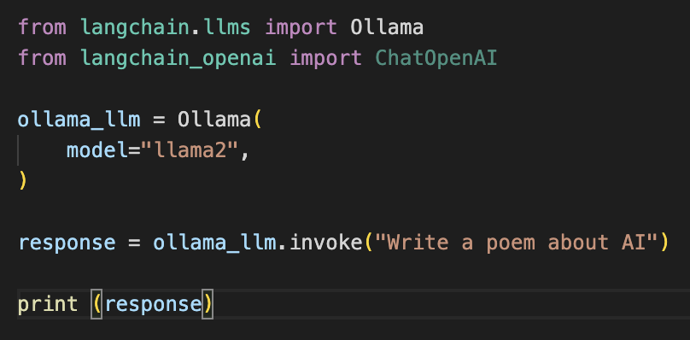
You can use OLLAMA for free
from langchain.llms import Ollama
from langchain_openai import ChatOpenAI
ollama_llm = Ollama(
model="llama2",
)
response = ollama_llm.invoke("Write a poem about AI")
print (response)
You must install Ollama locally

Slide 20
Next Steps:
Explore more features of LangChain.
Implement more complex workflows.
Check the provided GitHub repository for source code and additional resources.

Slide 21
Resources
GitHub Repository: [Link]
LangChain Documentation: [Link]
OpenAI API Documentation: [Link]

